Slide 1
Excel Project on
HIRING PROCESS
ANALYTICS
-Ananya Shetty

Slide 2
Project Description
This data analysis project is aimed to analyze the company’s hiring process data. The hiring process is a crucial function of any company, and understanding trends such as the number of rejections, interviews, job types, and vacancies can provide valuable insights for the hiring department. Here, we are analyzing the data using Excel to improve the company’s hiring process
Approach
The approach involved handling missing data, detecting and handling outliers, summarizing data, and creating visualizations using Excel. After cleaning and preparing the data, I summarized my findings using statistical measures and created visualizations using Excel charts and graphs
Tech - Stack used
I used Microsoft Excel for analysis and visualisation. Excel was chosen due to its easy-to-use, powerful data manipulation capabilities, and built-in charting and graphing features.

Slide 3
Initial Steps
Handling Missing Data : There were 15 missing values in “event_name” column. Replaced it with “Don’t want to say”.
There were 1 missing values in “Post Name” and “Offered Salary” each. Replaced it with “c5” and “49990” respectively. These changes were made by taking “department”, “Post Name” “Offered Salary” and “event_name” into consideration, by taking average for the “Offered Salary” and mode for the “Post Name”
Post Name -> replaced c-10 to c10 for 232 records
Handline Outliers :
By using the formula =QUARTILE(), Q1, Q3, IQR, Low and High were calculated and then using these values outliers were detected.
3 outliers found were found, and removed those 3 records.

Slide 4
DATA SUMMARY
Data Summary
Salary Mean | 49878.35
Salary Median | 49625
Salary Mode | 72843
Count of Male | 4084
Count of Female | 2673
Count of Hired Male | 2562
Count of Hired Female | 1854
Maximun Salary | 99967
Minimum Salary | 100
No. of Departments | 9
No. of Post | 15

Slide 5
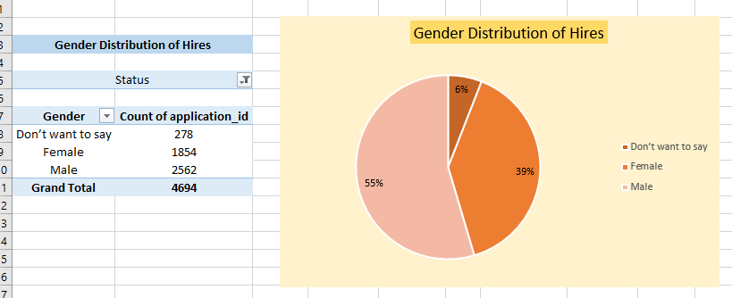
Insights
Hiring Analysis
Hiring Analysis: The hiring process involves bringing new individuals into the organization for various roles.
Your Task: Determine the gender distribution of hires. How many males and females have been hired by the company?

Slide 6
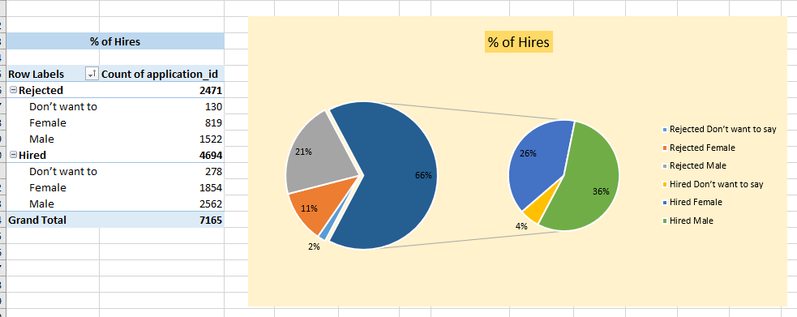

Slide 7
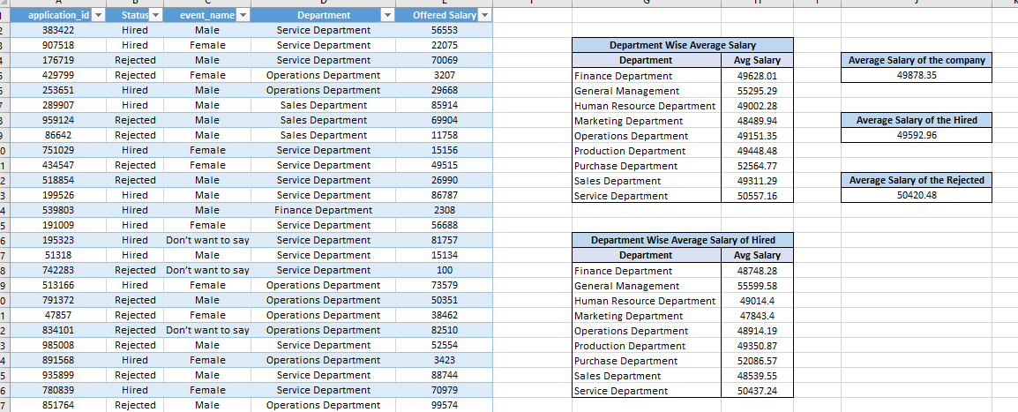
Salary Analysis
Salary Analysis: The average salary is calculated by adding up the salaries of a group of employees and then dividing the total by the number of employees.
Your Task: What is the average salary offered by this company? Use Excel functions to calculate this.

Slide 8
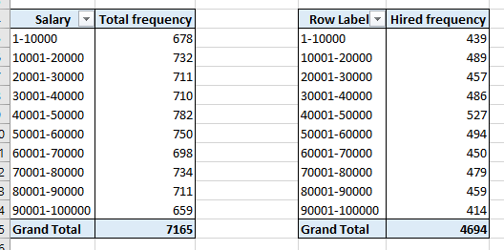
Salary Distribution
Salary Distribution: Class intervals represent ranges of values, in this case, salary ranges. The class interval is the difference between the upper and lower limits of a class.
Your Task: Create class intervals for the salaries in the company. This will help you understand the salary distribution.

Slide 9
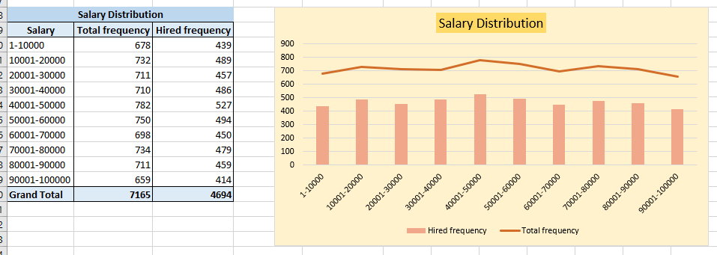

Slide 10
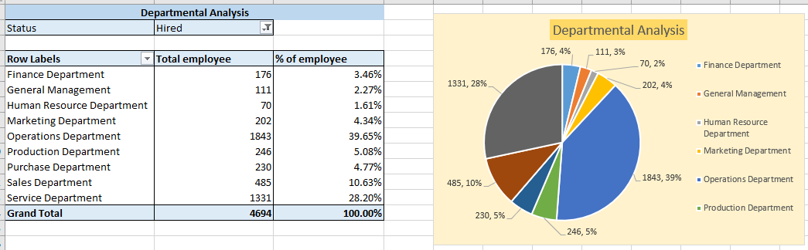
Departmental Analysis
Departmental Analysis: Visualizing data through charts and plots is a crucial part of data analysis.
Your Task: Use a pie chart, bar graph, or any other suitable visualization to show the proportion of people working in different departments.

Slide 11
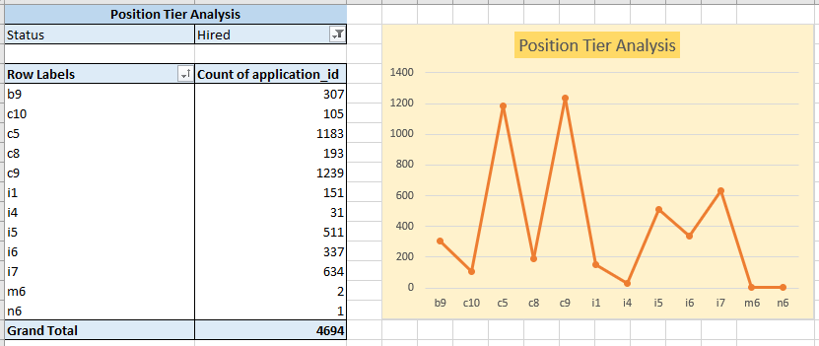
Position Tier Analysis
Position Tier Analysis: Different positions within a company often have different tiers or levels.
Your Task: Use a chart or graph to represent the different position tiers within the company. This will help you understand the distribution of positions across different tiers.

Slide 12
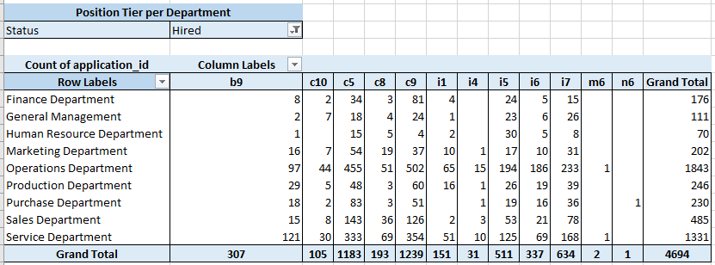
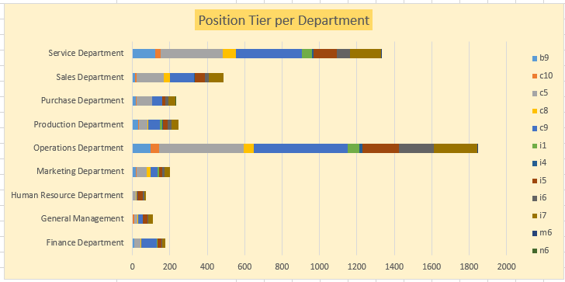

Slide 13
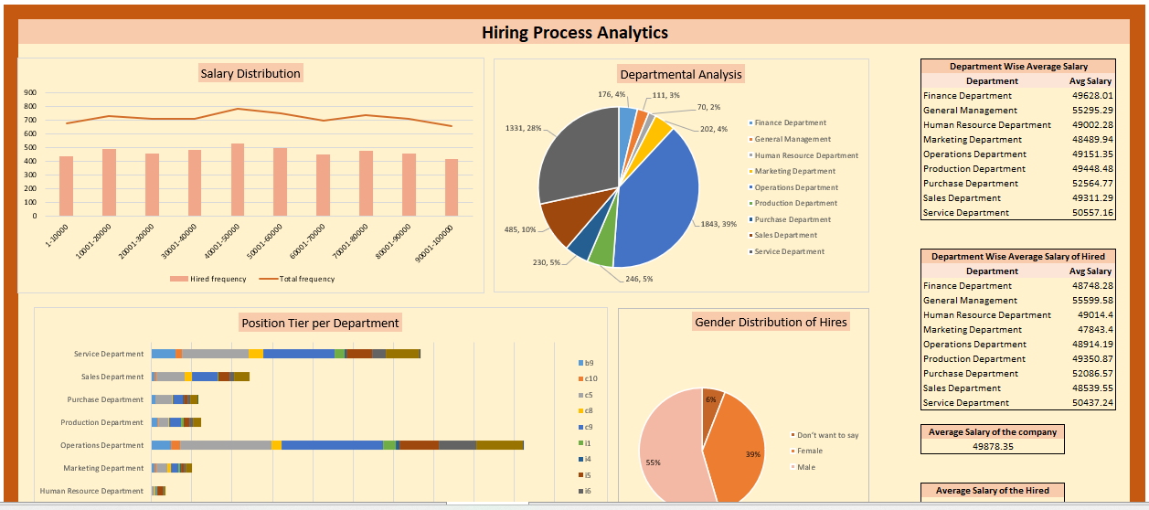
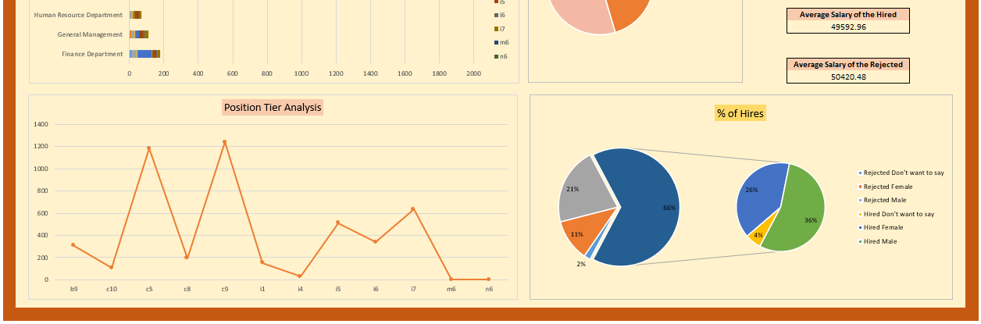
Click here to open the spreadsheet

Slide 14
RESULT
This project helped me in understanding the company's hiring process analytics. The insights gained from this project can help the company improve its hiring process. The visualizations created using Excel charts and graphs provide a clear and concise representation of the data, making it easier to identify trends and patterns. Overall, this project demonstrates the importance of data analysis in informing business decisions and improving operational efficiency.

Slide 15
THANK YOU

